Slide 1
PseudoCoder
C++ code generator from algorithm
Shazzad Hossain
BSSE-1203

Slide 2
What is PseudoCoder?
An algorithm implementation program
Takes an algorithm as input
Generates a C++ code as output

Slide 3
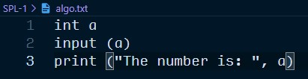
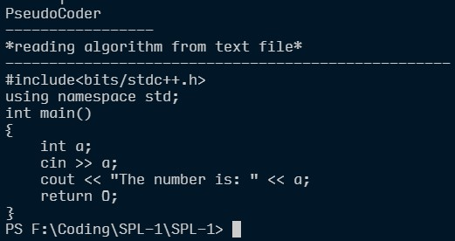
An algorithm is taken as input and a C++ code is generated as an output

Slide 4
Motivation of the Project
Help beginners to focus more on the problem solving aspect first.
Help beginners to develop their critical thinking and to improve their skill of how to approach a problem.
Suits the criteria of SPL-1 as it focuses on how to implement an algorithm and how to manipulate strings on a large extent.

Slide 5

What are the challenges?
Learning C++ in depth to generate a code from algorithm
Implementation of logic by reading and analysing an algorithm

Slide 6

Progress so far…
Variable Declaration
Input and Output streams
Conditional Statement implementation
Nested Conditionals
Handling

Slide 7
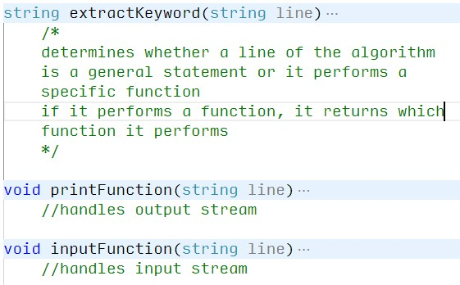
Functions created so far…

Slide 8
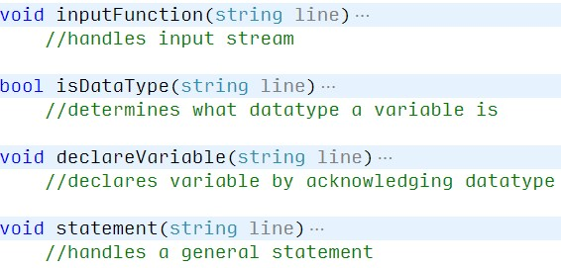
Continued…

Slide 9
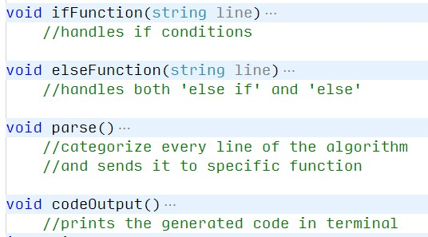
Continued…

Slide 10
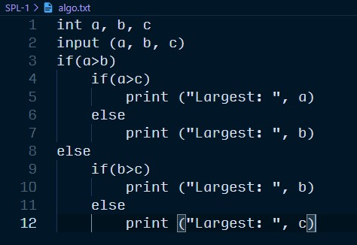
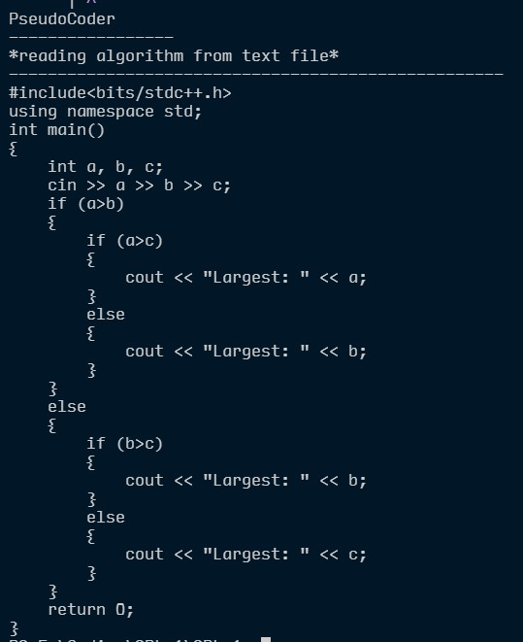
Input:
Output:

Slide 11

More things to implement…
For loop
While loop
Function creation
Function calling

Slide 12
Thank You!
GitHub link (with the source code) of the project:
https://github.com/shazzad5709/SPL-1

